Slide 1
Ratings Prediction
SUBMITTED BY
Krishna Prasad

Slide 2


Slide 3
Introduction
Rating prediction is a well-known recommendation task aiming to predict a user's rating for those items which were not rated yet by her.
Predictions are computed from users' explicit feedback, i.e. their ratings provided on some items in the past.
In this Project I have done Web Scraping by using Electronics goods that is phones,smart watches,headphones, laptops etc.
After completing Web scrapping and converting all the scrap data into Dataset. From which I understand from this dataset I have to predict Ratings_of_the_product.

Slide 4
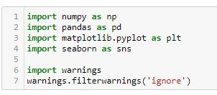
Importing Libraries

Slide 5
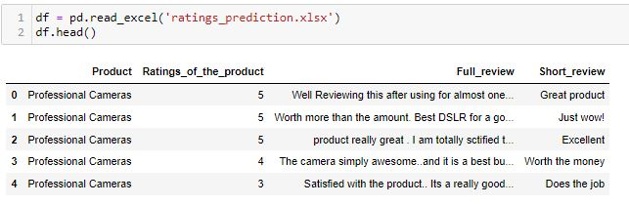
Loading excel data

Slide 6
EDA – Exploratory Data Analysis

Slide 7

CHECKING ROWS & COLUMNS

Slide 8
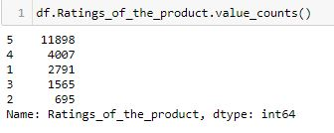
Value Counts

Slide 9
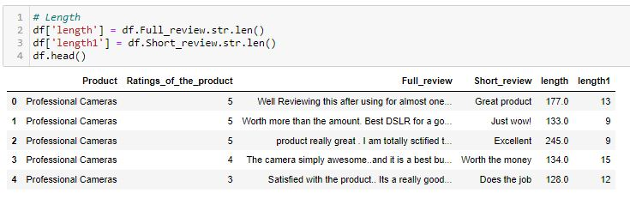
Checking Len of Features Columns

Slide 10
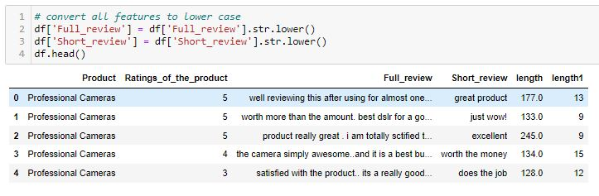
Converting Features in lower Case

Slide 11
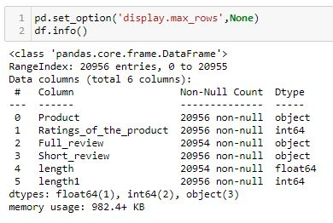
Checking columns type

Slide 12
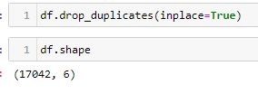
Checking Duplicates

Slide 13
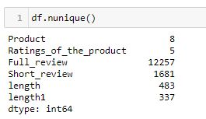
Checking Continuous & Categorical Columns

Slide 14
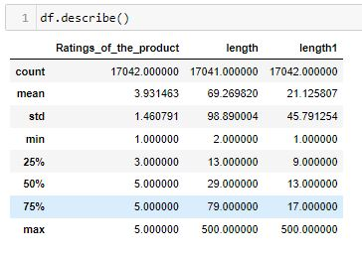
Describe

Slide 15
Data Visualizations

Slide 16
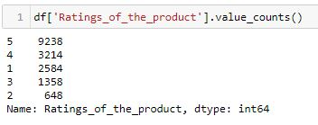
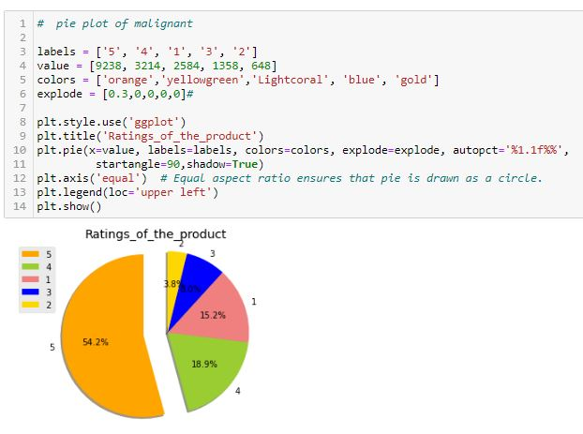
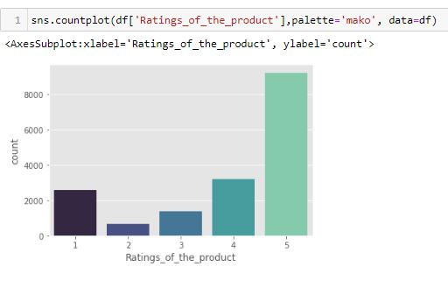
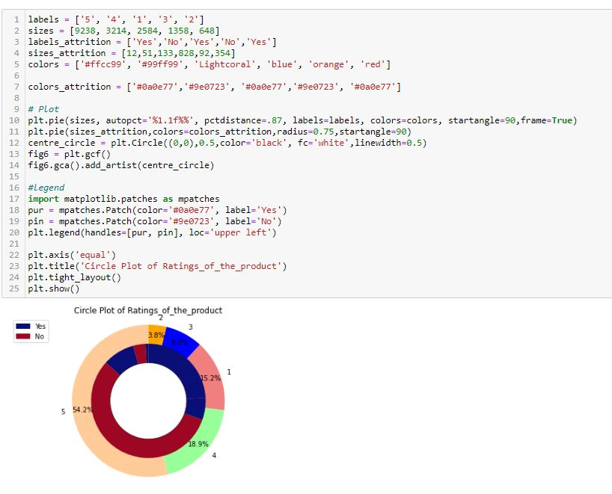
Ratings_of_the_product

Slide 17
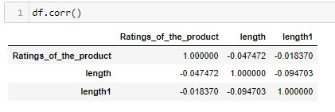
Correlation

Slide 18
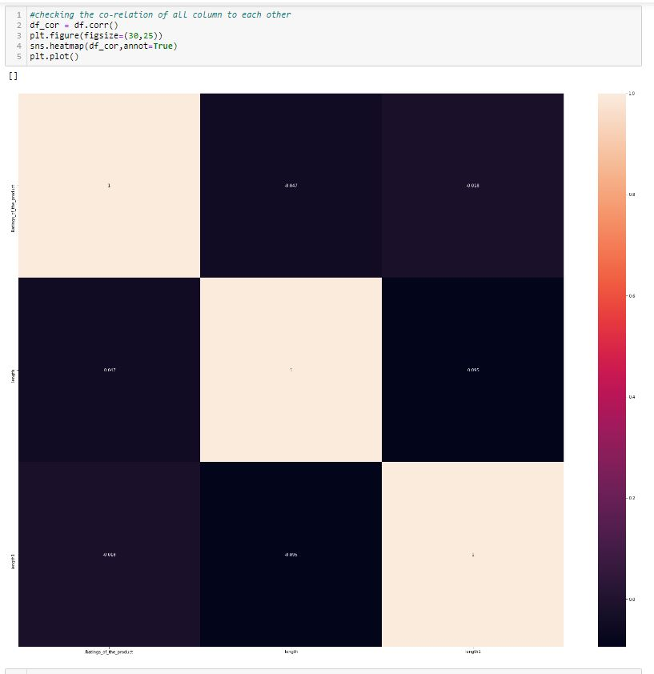
Heat map

Slide 19
Nlp – Natural Language Processing

Slide 20
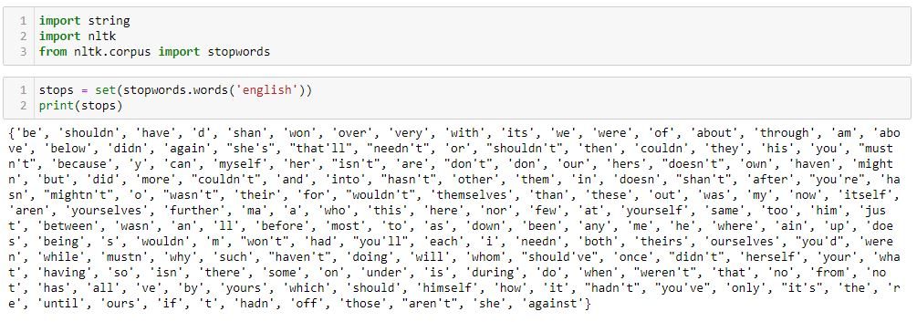
Removing Stopwords

Slide 21
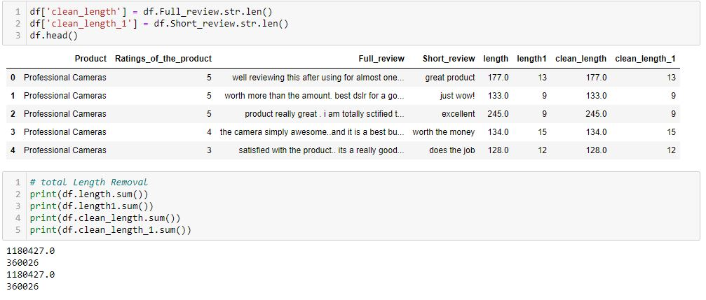
Cleaning Features Columns

Slide 22
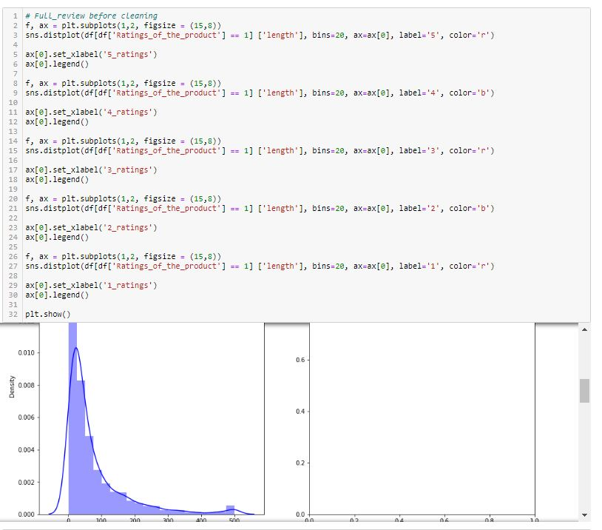
Distribution Plot before cleaning & after Cleaning

Slide 23
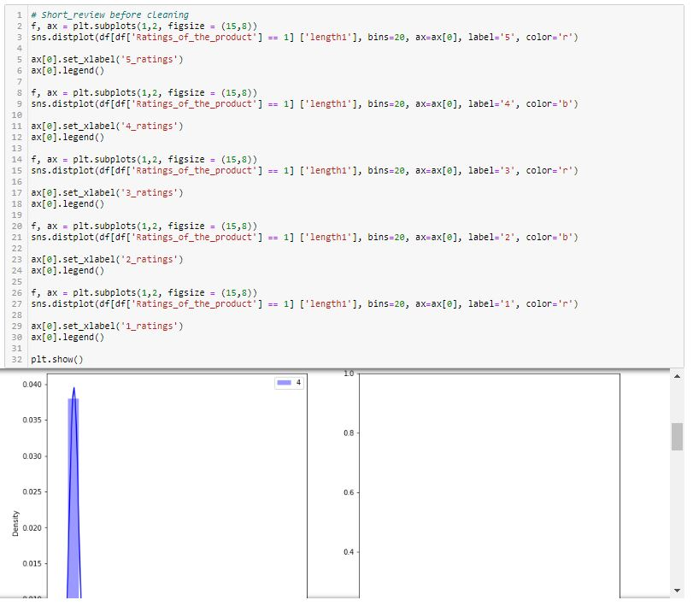

Slide 24
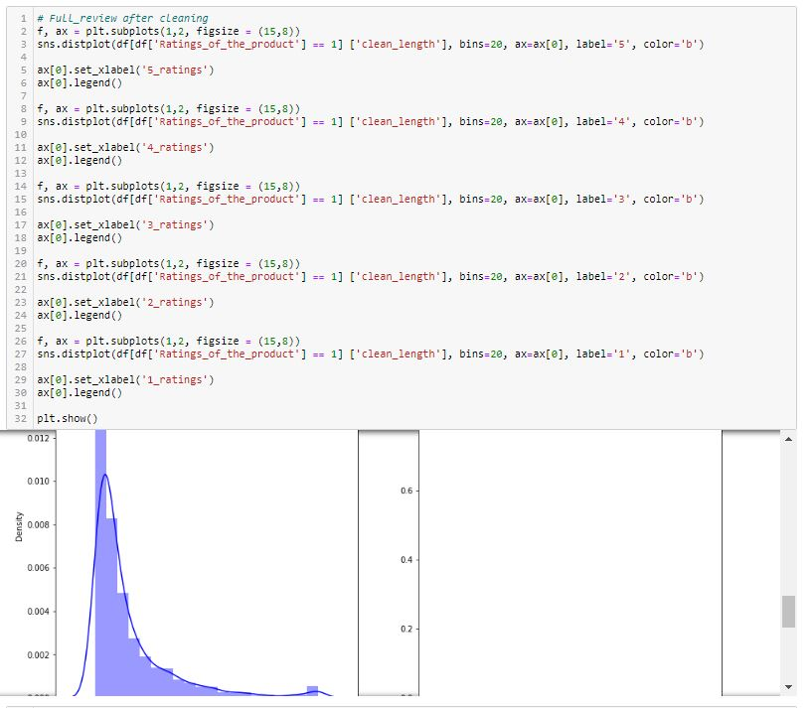

Slide 25
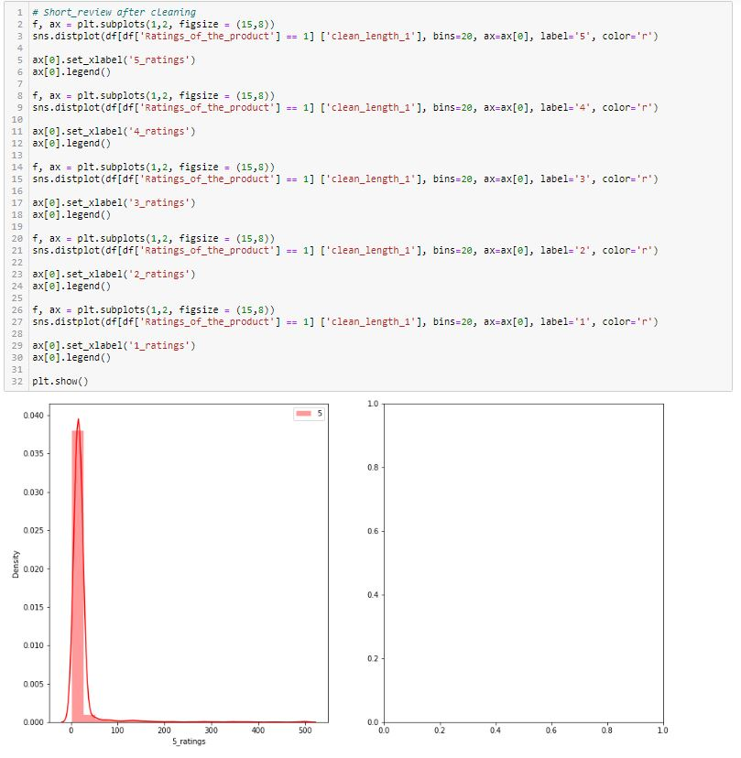

Slide 26
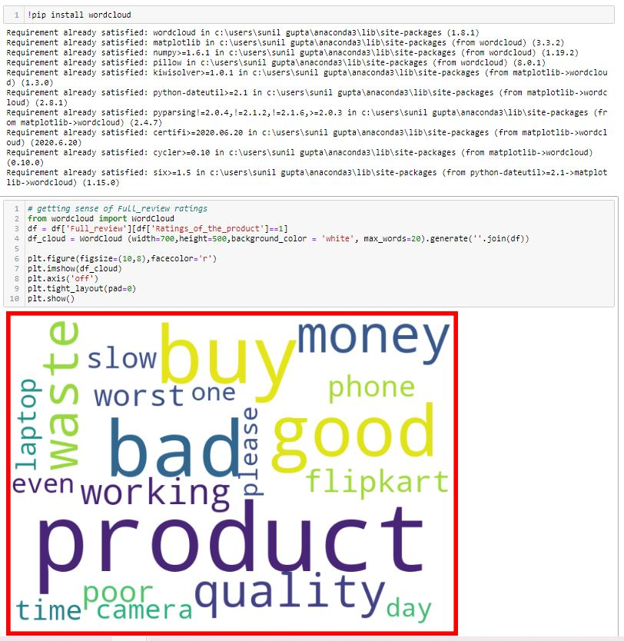
Word Cloud

Slide 27
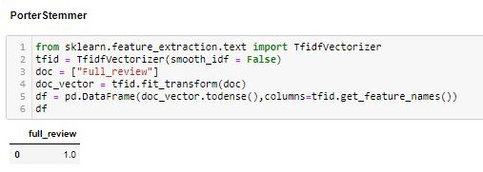
Porter Stemmer

Slide 28
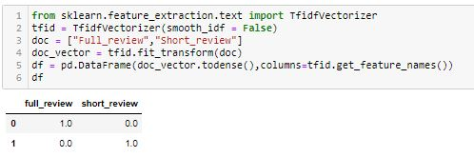
Tfidf Vectorizer

